Slide 1
What makes an appropriate source
Discuss reference sources
Narrowing your topic
Identify search terms to find journal articles
Using Nexus-uni
Finding books
Creating MLA citations

Slide 6
Zombies

Slide 7
The zombie genre is a metaphor for the depersonalizing power of consumerism.

Slide 9
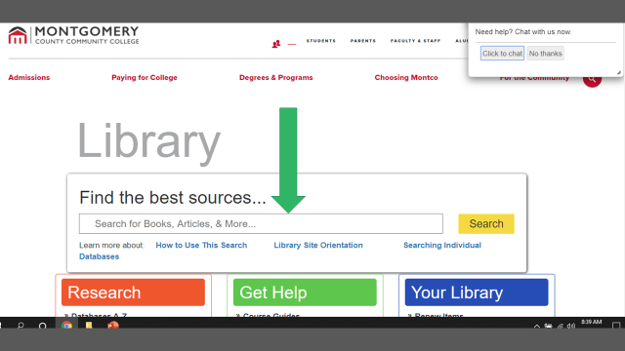

Slide 10
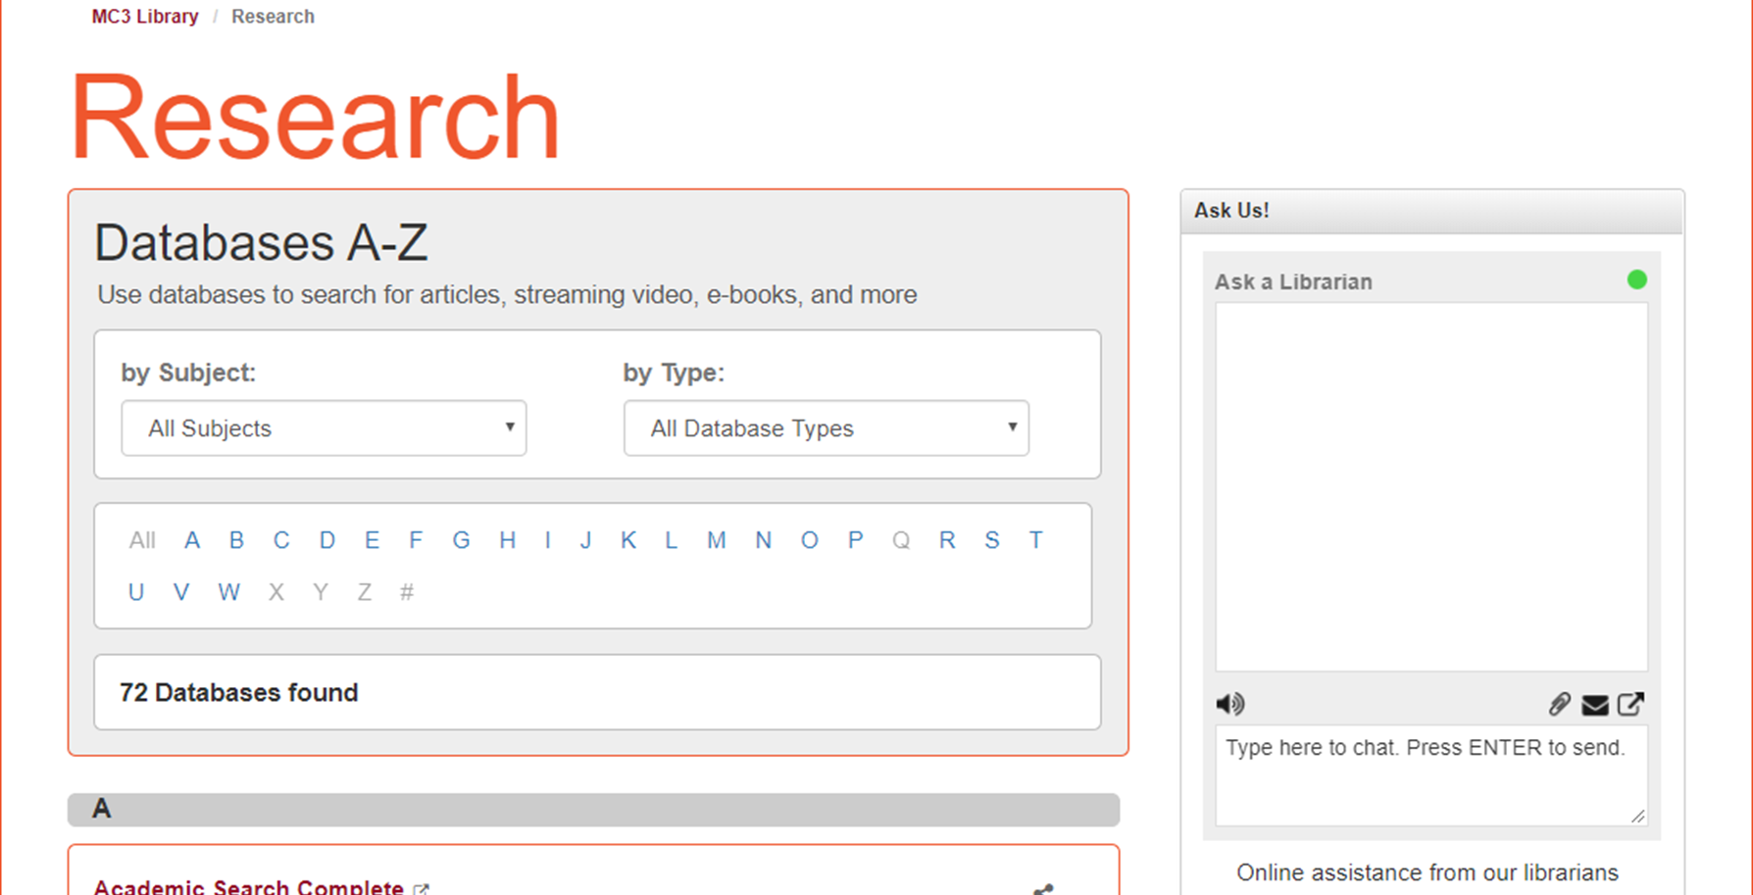

Slide 11
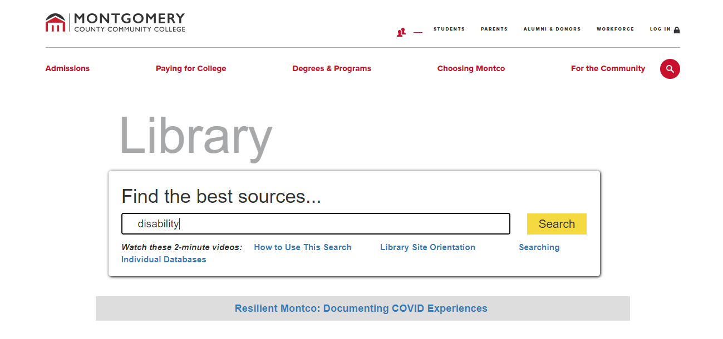
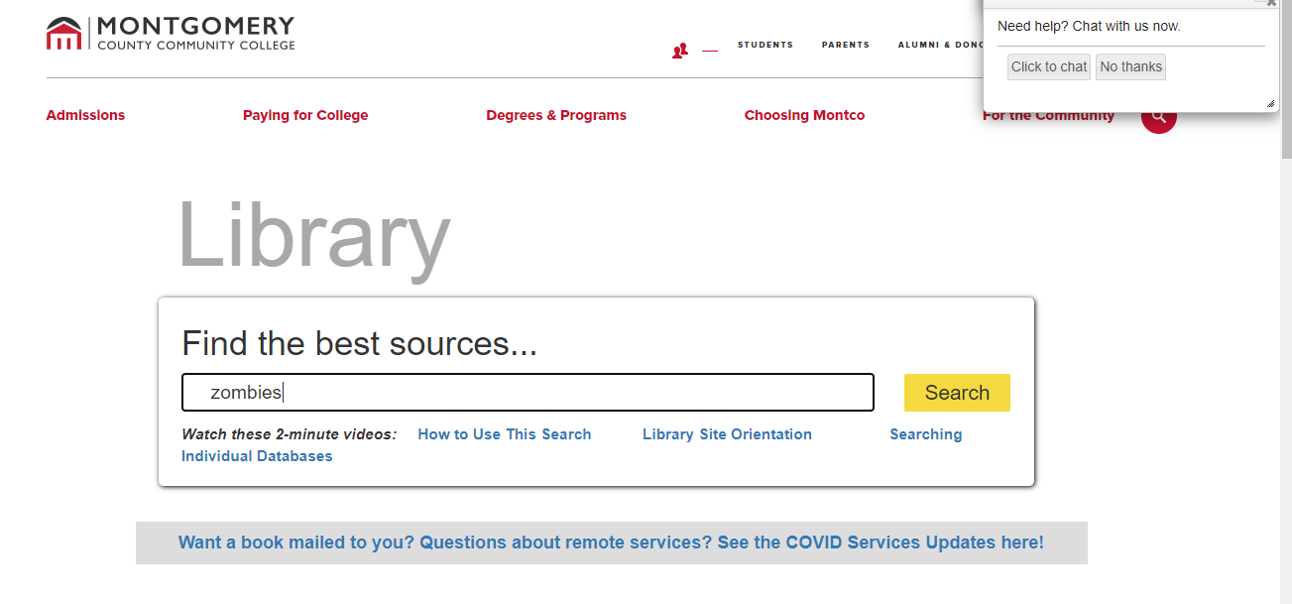

Slide 12
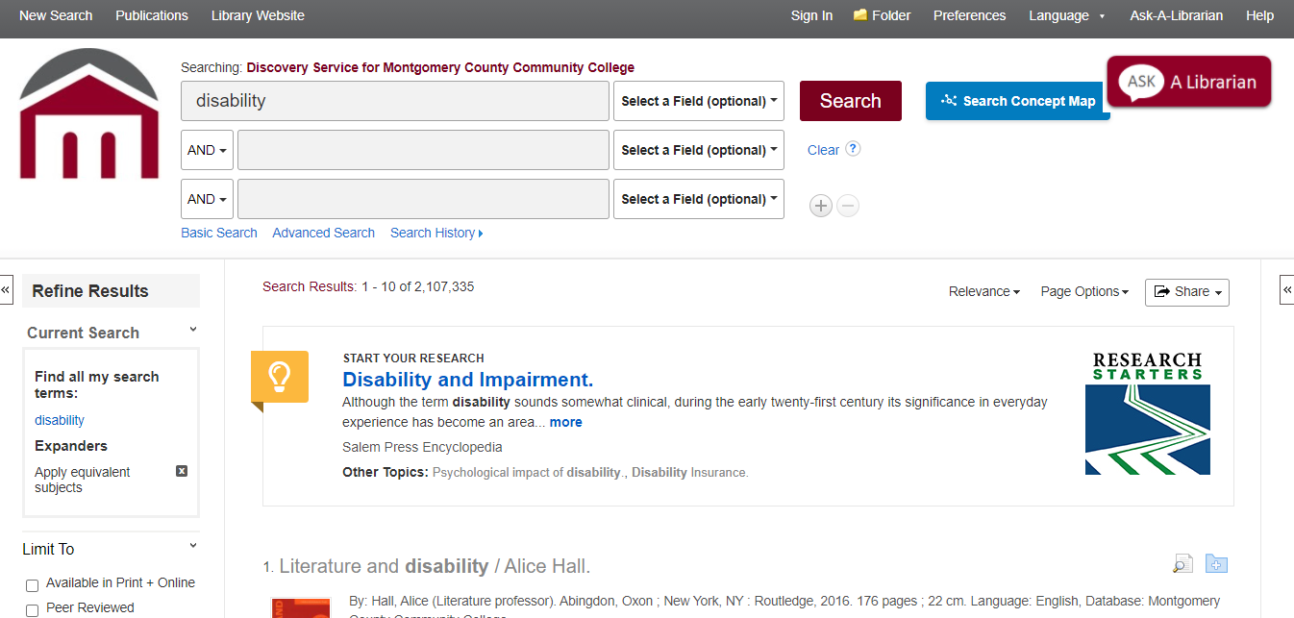
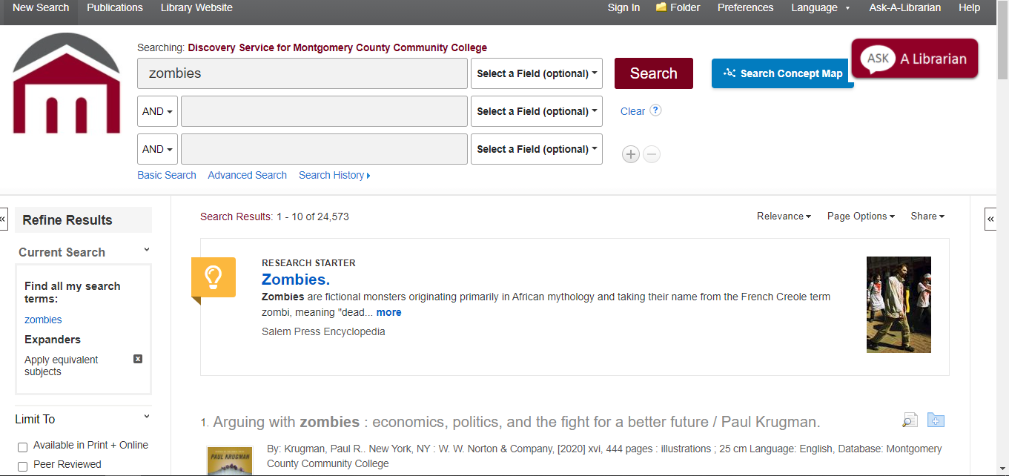

Slide 13
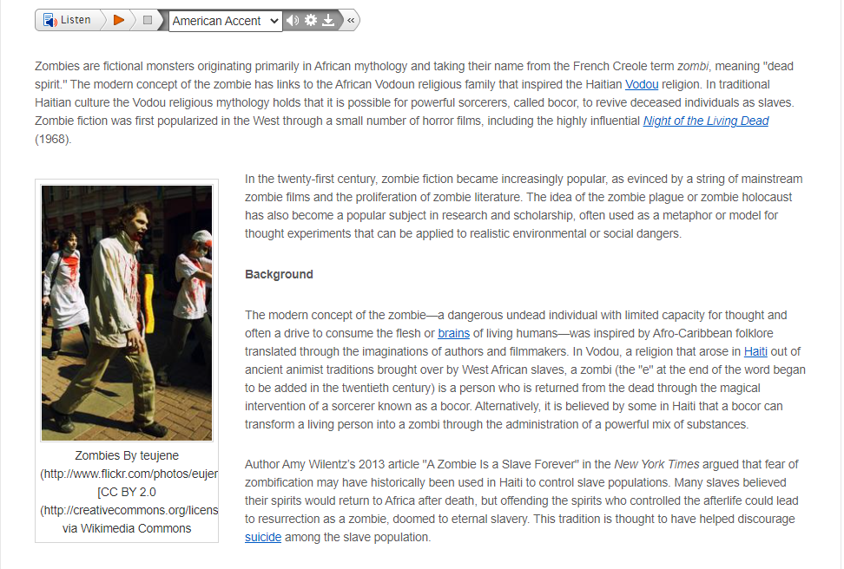
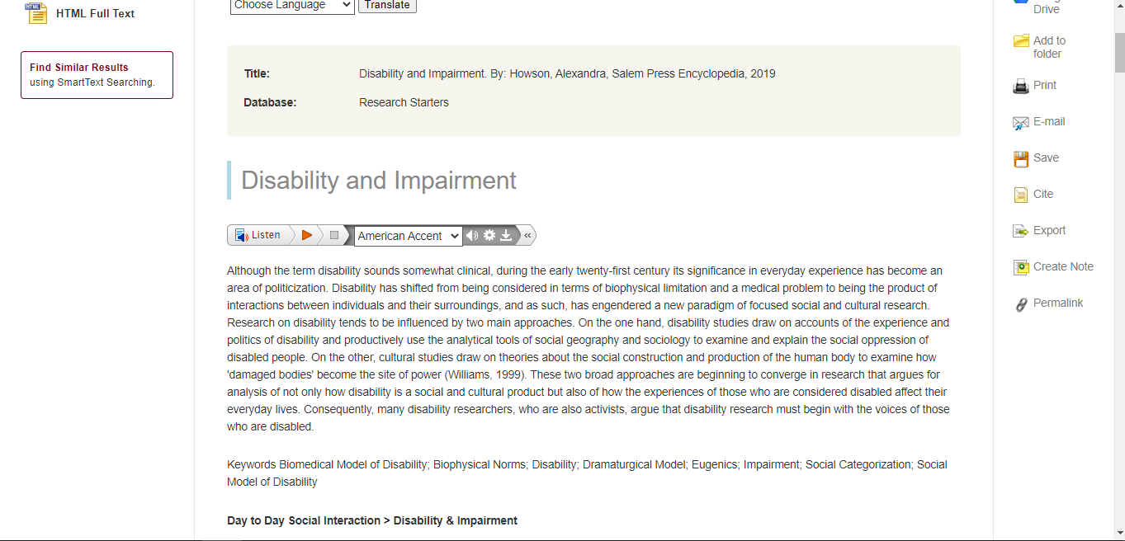

Slide 14
Other useful reference databases
CQ Researcher
Opposing Viewpoints
Notes:
Don’t forget to discuss benefits of pro/con sections and information and if they are looking for ideas

Slide 15
What is a scholarly article?
You need at least one of them.

Slide 16
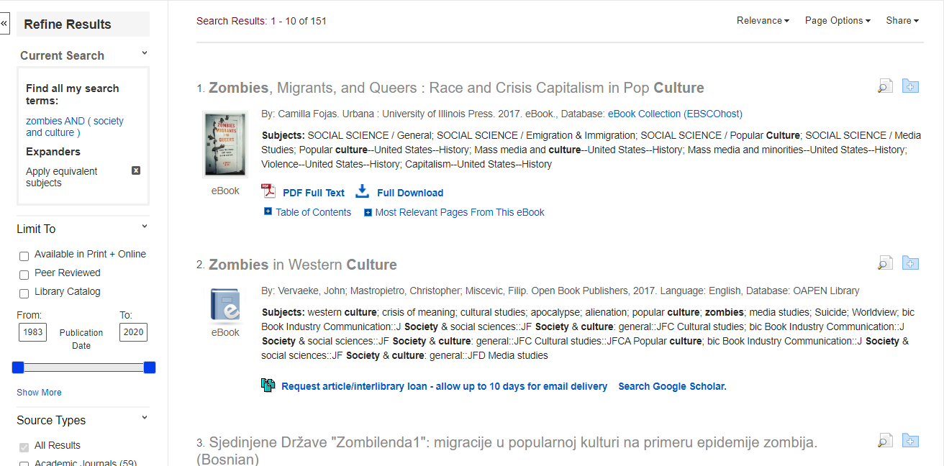

Slide 17
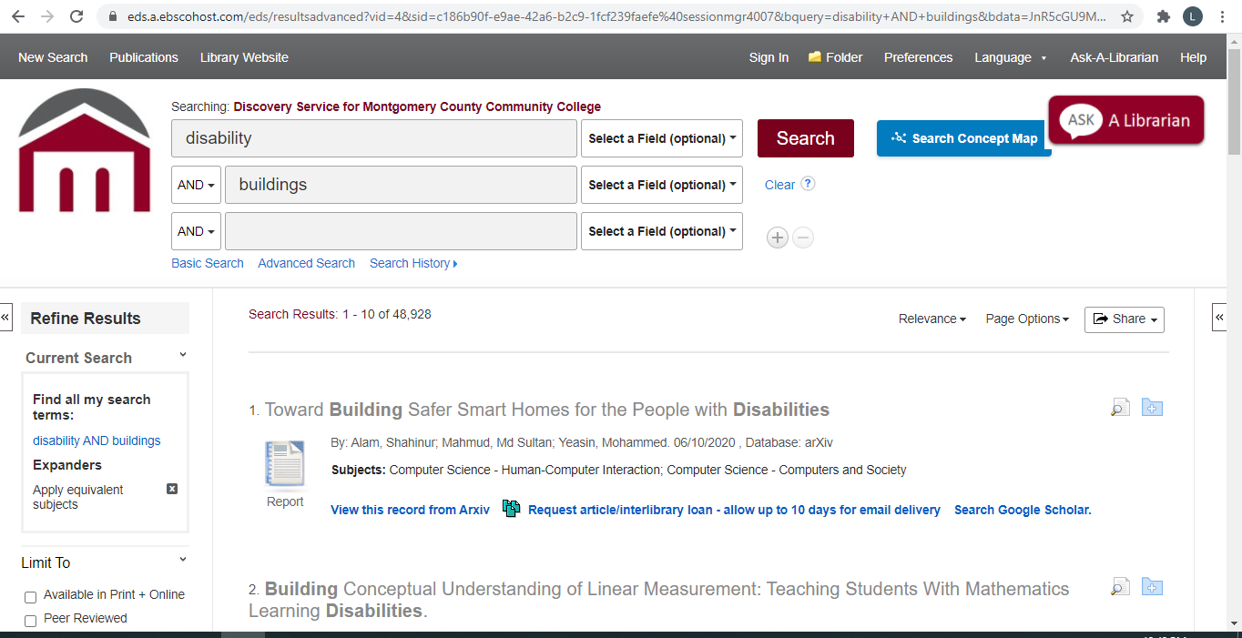
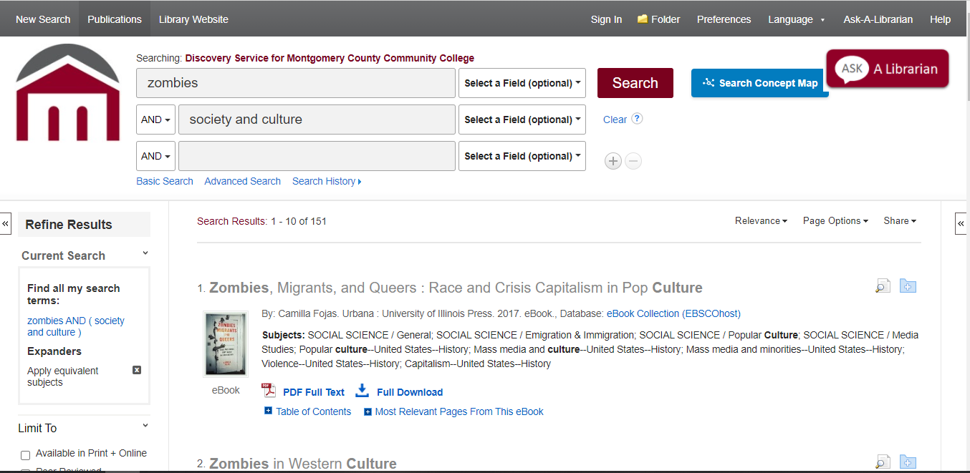

Slide 18
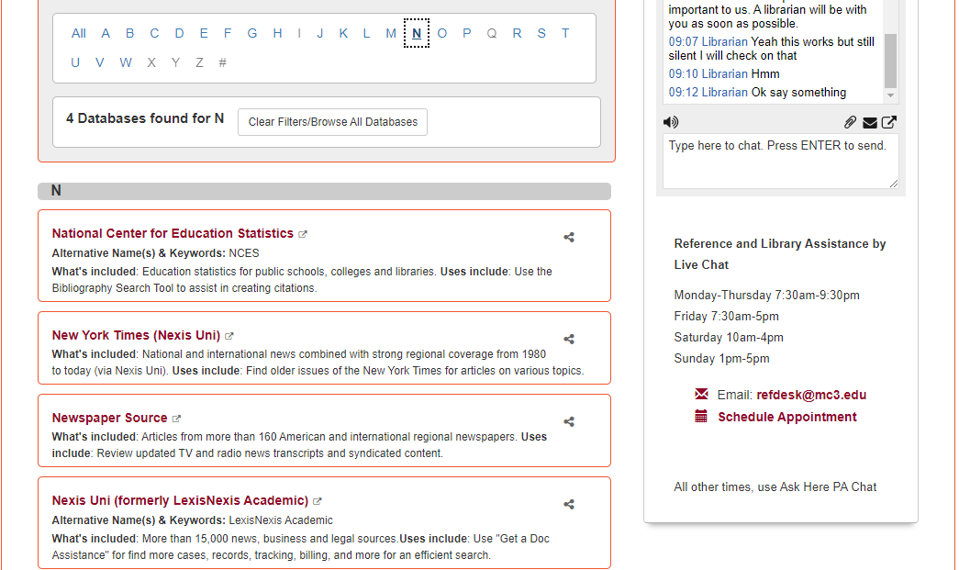

Slide 19
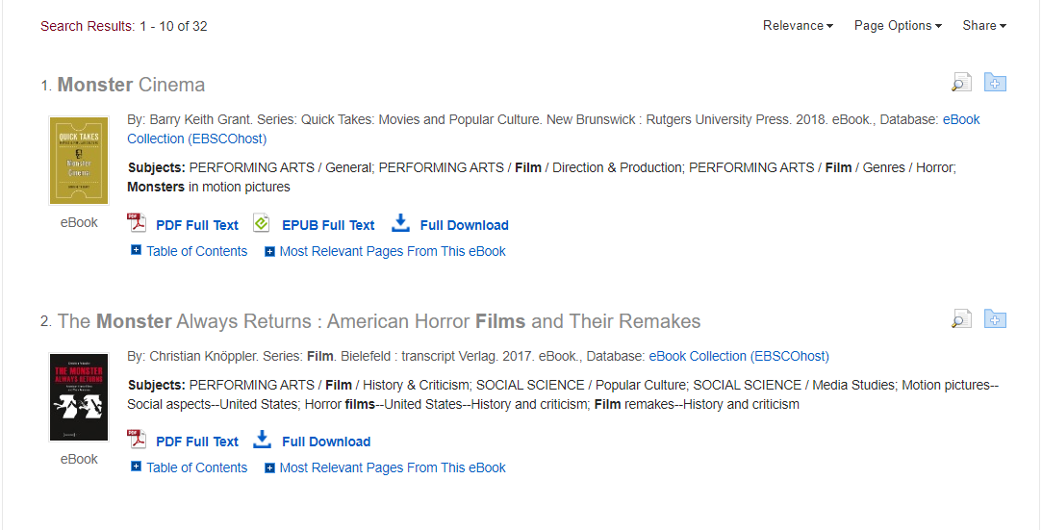
Multiple ebooks available for this assignment

Slide 20
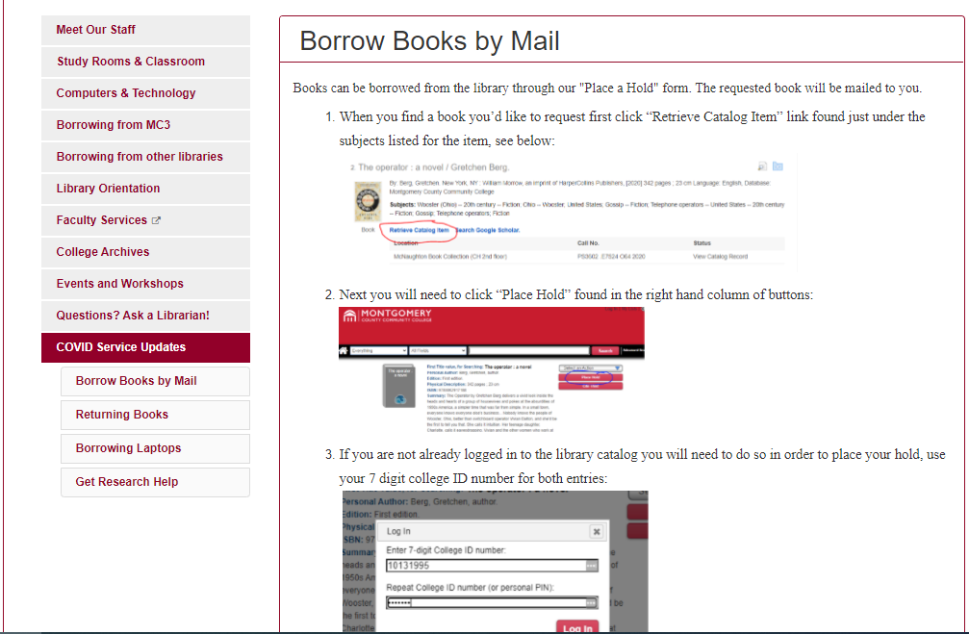
You can get a library book mailed to you.

Slide 22
Evaluating websites

Slide 23
MLA Help
MLA Sample Paper

